Slide 1
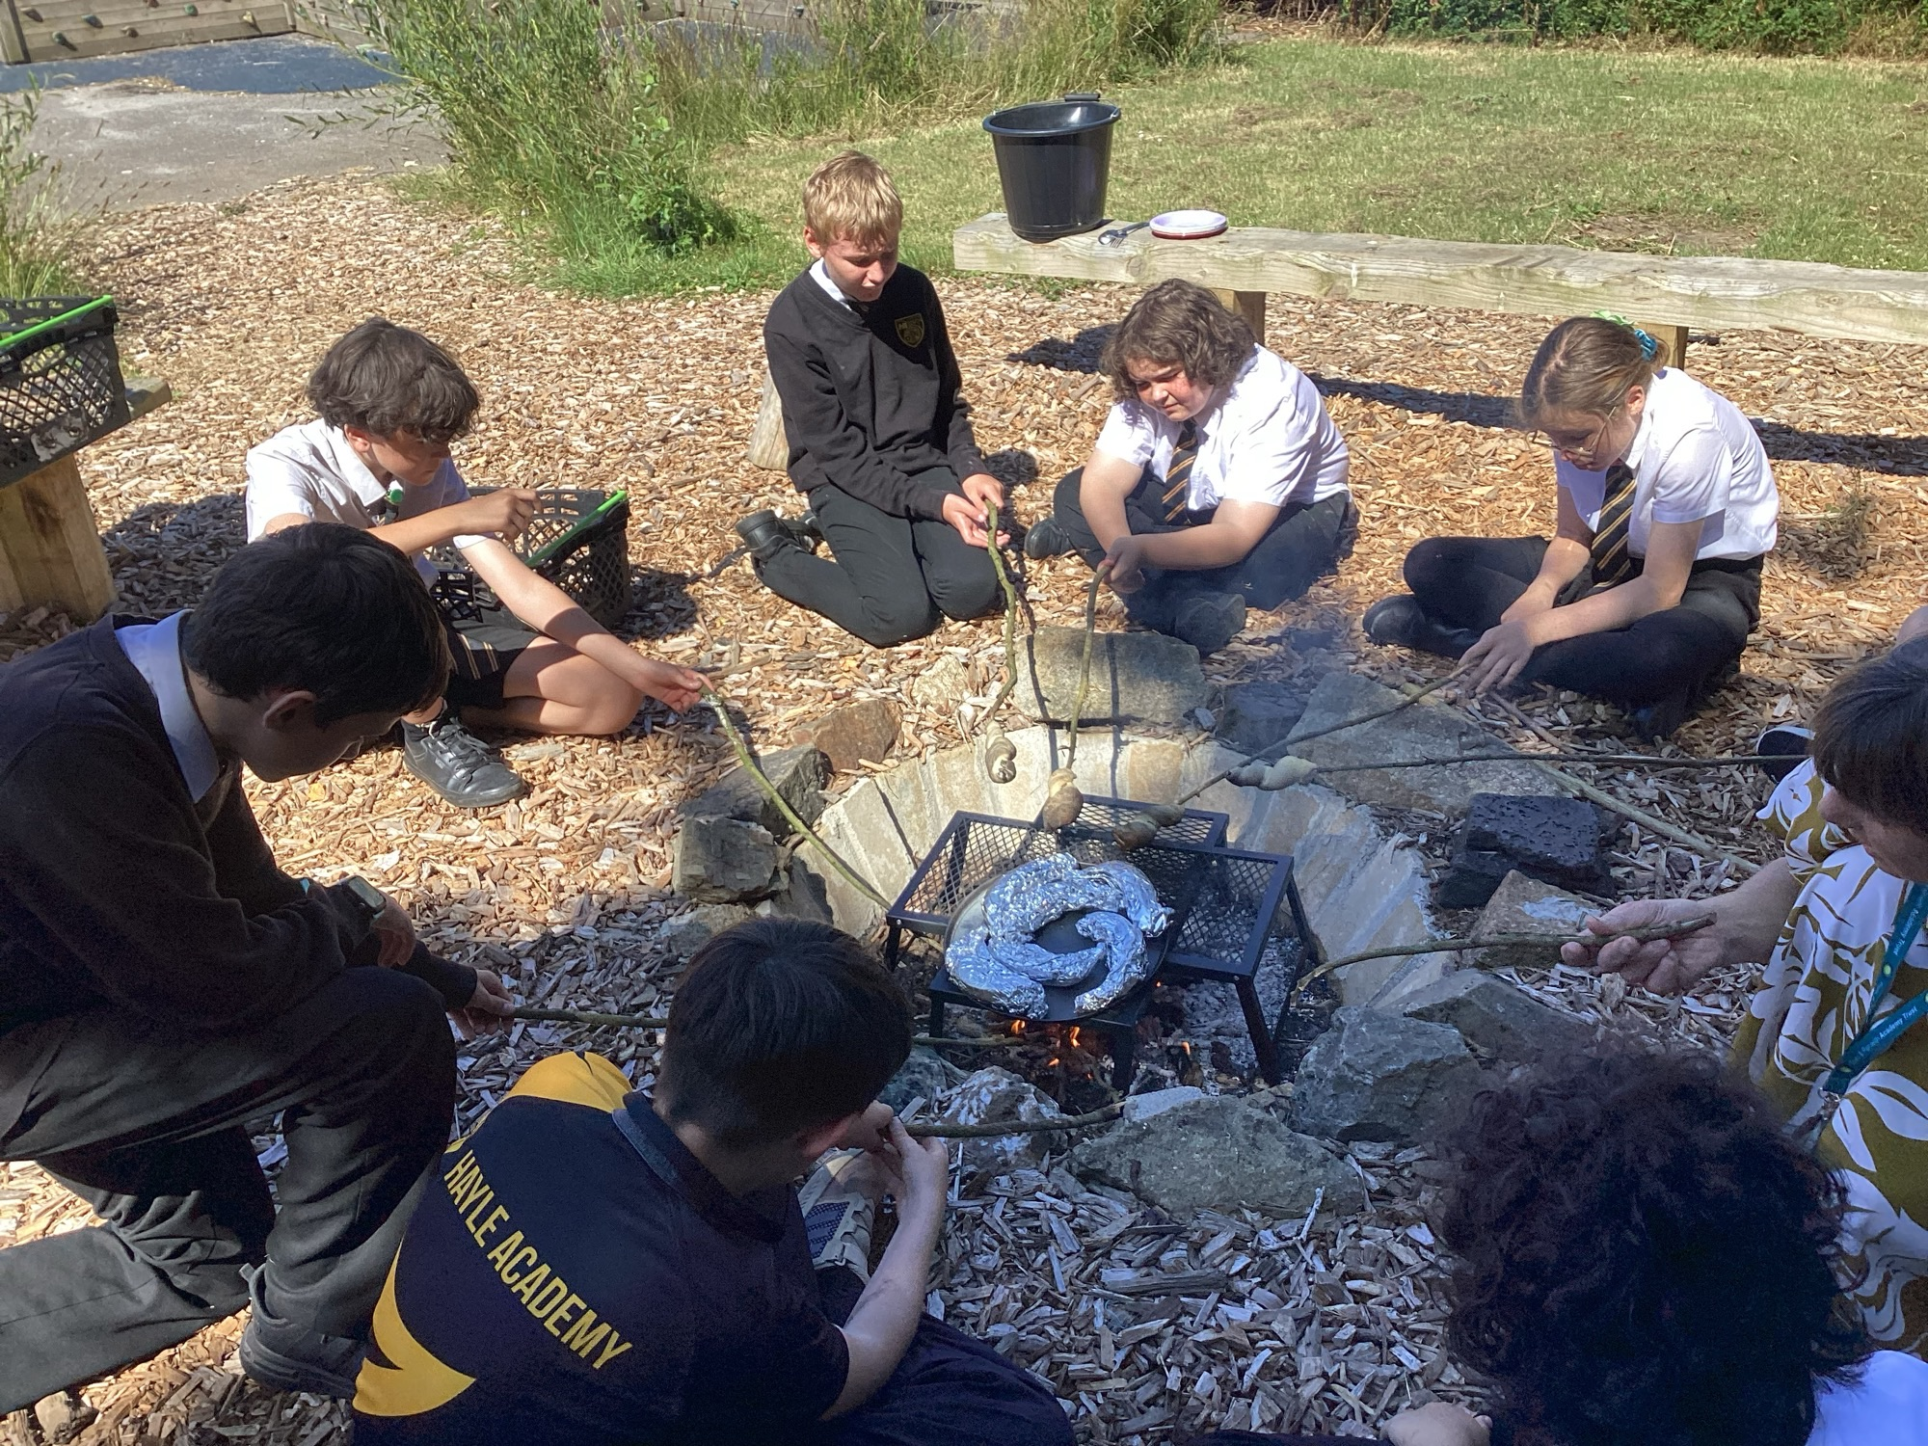
SEND at Hayle Academy
KEY GUIDANCE AND INFORMATION FOR SPECIAL EDUCATIONAL NEEDS AT HAYLE ACADEMY
2025-2026

Slide 2
CURRICULUM OFFER
“
OUR MORAL COMPASS AND INTENT
Create a positive and supportive environment for all pupils so that they achieve success
An inclusive school removes all barriers to learning and participation, provides an education that is appropriate to pupils’ needs, and promotes high standards and the fulfilment of potential for everyone.
That’s why at Hayle Academy we focus on the individual: students are encouraged to try new things, develop confidence and build resilience within our positive, encouraging and child-centred community.
“

Slide 3


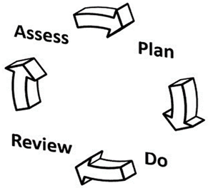


OUR SCHOOL COHORT
BREAKDOWN FOR THE 2025 –2026 COHORT
There are four broad areas of need within SEND:
Cognition and Learning Needs
Communication and Interaction Needs
Social, Emotional and Mental Health Needs
Sensory and/ or Physical Needs
As stated in the Code of Practice:
“These four broad areas give an overview of the range of needs that should be planned for. The purpose of identification is to work out what action the school needs to take, not to fit a pupil into a category. In practice, individual children or young people often have needs that cut across all these areas and their needs may change over time. For instance, speech, language and communication needs can also be a feature of a number of other areas of SEN, and children and young people with an Autistic Spectrum Disorder (ASD) may have needs across all areas, including particular sensory requirements. The support provided to an individual should always be based on a full understanding of their strengths and needs and seek to address them all using well - evidenced interventions targeted at their areas of difficulty and where necessary specialist equipment or software”
.
We have 125 students with SEND which equates to 19.9% of our school population (630 on roll). This compares to 18.4% nationally and 18.9% in Cornwall. This means we have roughly 36 more students with SEN than a similar sized school or 14 more if we remove the ARB from these figures.
We have 103 students on SEN support (16.3%) compared to national (13.8%) and Cornwall (15.3%).
Hayle Academy has 38 students with an EHCP (including our ARB and those delayed in gaining their EHCP). This equates to 6.3% of our school roll. This compares to 4.8% nationally and 3.6% in Cornwall meaning we have 22 more students with an EHCP than a similar sized school. (including our ARB).
If we remove the ARB from these figures, we have 16 students with an EHCP which is 2.54%.
There are 78 boys in the cohort and 46 girls with SEND. This is a 63.5% : 36.5% split.

Slide 4
OUR SCHOOL COHORT
BREAKDOWN OF SEN NEEDS 2025-2026
When we look at the breakdown in needs within our cohort of students with SEN we see we have roughly similar proportions of each need compared to Cornwall and National.
.
Special Educational Needs | Hayle Academy | National | Cornwall
Specific Learning Difficulty | 24% | 11.7% | 13.1%
Moderate Learning Difficulty | 24.8% | 15.3% | 15.7%
Severe Learning Difficulty | 2.4% | 2.3% | 1.7%
Profound and Multiple Learning Difficulty | 0.8% | 0.8% | 0.5%
Social, Emotional and Mental Health | 31.2% | 19.6% | 21.3%
Speech, Language & Communication | 28% | 23.7% | 23.2%
Hearing Impairment | 0.8% | 1.6% | 1.2%
Visual Impairment | 0.8% | 0.9% | 0.7%
Multi sensory impairment | 0% | 0.3% | 0.8%
Physical Disability | 2.4% | 2.5% | 2.5%
Autism Spectrum Condition | 13.6% | 14.2% | 10.5%
Other disability | 3.2% | 3.6% | 4.3%
No specialist assessment | 2.4% | 3.4% | 4.5%

Slide 5
SEND STRATEGY
THE IMPLEMENTATION OF OUR PROVISION
1. CREATE A POSITIVE AND SUPPORTIVE ENVIRONMENT FOR ALL PUPILS WITHOUT EXCEPTION - An inclusive school removes barriers to learning and participation, provides an education that is appropriate to pupils’ needs, and promotes high standards and the fulfilment of potential for all pupils. We should:
promote positive relationships, active engagement, and wellbeing for all pupils;
ensure all pupils can access the best possible teaching which prepares them well for their next stage;
adopt a positive and proactive approach to behaviour
2. BUILD AN ONGONG, UNDERSTANDING OF YOUR PUPILS AND THEIR NEEDS - We should aim to understand individual pupil’s learning needs using the Individualised Leaning Plans on Edukey as well as discussions with the SEN team. These plans shows the things each student need and feel that supports them in the classroom as well as the things they can focus on for themselves.
Tutors play an important role in understanding need with the termly SEN review meetings held at the end of each of the Autumn, Spring and Summer terms and phone calls home to parents/carers.
3. ENSURE ALL PUPILS HAVE ACCESS TO HIGH QUALITY TEACHING
Good teaching for pupils with SEND is good teaching for all. Searching for a ‘magic bullet’ can be distracting and we miss the powerful strategies you already possess. Teachers should develop a repertoire of these strategies they can use flexibly in response to the needs of all pupils.
flexible grouping and scaffolding or support to achieve the learning goal
cognitive and metacognitive strategies;
explicit instruction (chunked information, task boards / tasks PPT slide);
using technology to support pupils with SEND; including accessibility through Advantage
application of the Equity 8 strategy as non-negotiables in all teaching for SEN students
4. COMPLIMENT HIGH QUALITY TEACHING WITH EVIDENCE BASED SMALL GROUP AND ONE-TO-ONE INTERVENTIONS - Small-group and one-to-one interventions can be a powerful tool but must be used carefully. Ineffective use of interventions can create a barrier to the inclusion of pupils with SEN. High quality teaching should reduce the need for extra support, but it is likely that some pupils will require high quality, structured, targeted interventions to make progress. The intensity of intervention (from universal to targeted to specialist) should increase with need. Interventions should be carefully targeted through identification and assessment of need.
5. WORK EFFECTIVELY WITH TEACHING ASSISTANTS - Effective deployment of Teaching Assistants (TAs) is critical. Teachers and School leaders should pay careful attention to the roles of TAs and ensure they have a positive impact on pupils with SEND. TAs should supplement, not replace, teaching from the classroom teacher and foster independence in learning.

Slide 6
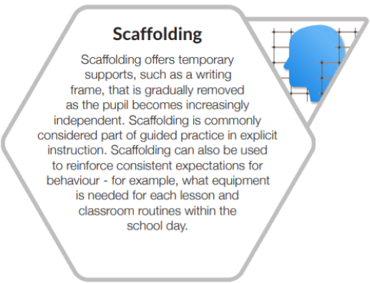
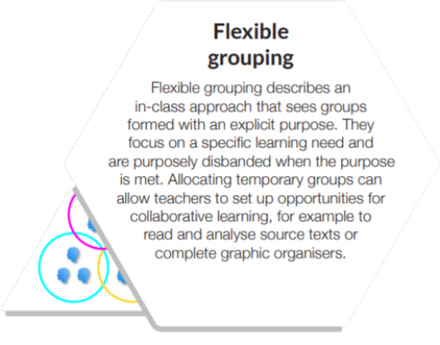
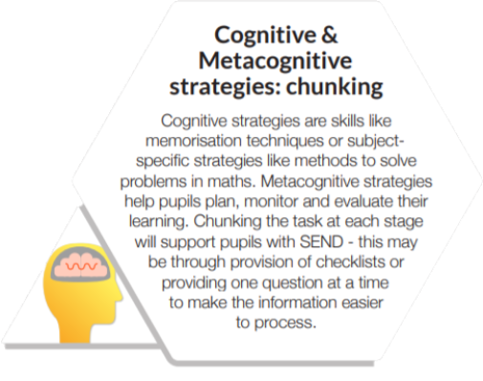
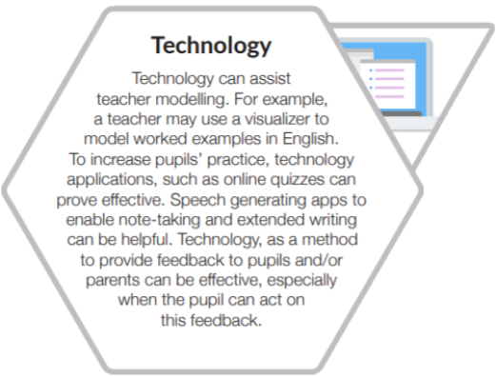
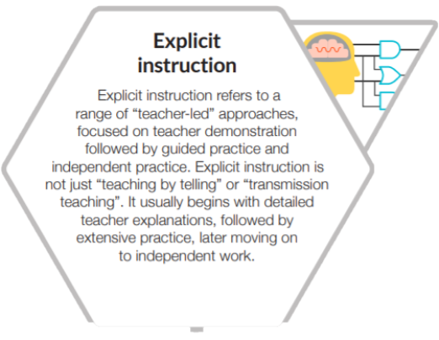
TEACHING AND LEARNING
THE IMPLEMENTATION OF OUR PROVISION
Improving high quality teaching for all pupils will improve outcomes for pupils with SEND. Teachers should develop a repertoire of these strategies they can use flexibly in response to individual needs and use them as the starting point for classroom teaching for all pupils, including those with SEND.

Slide 7
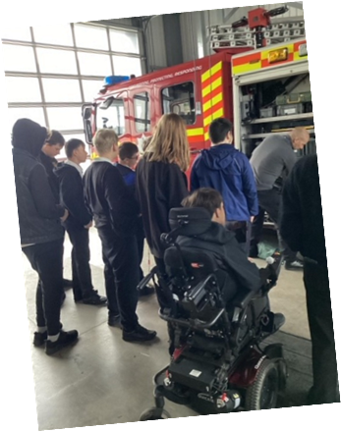
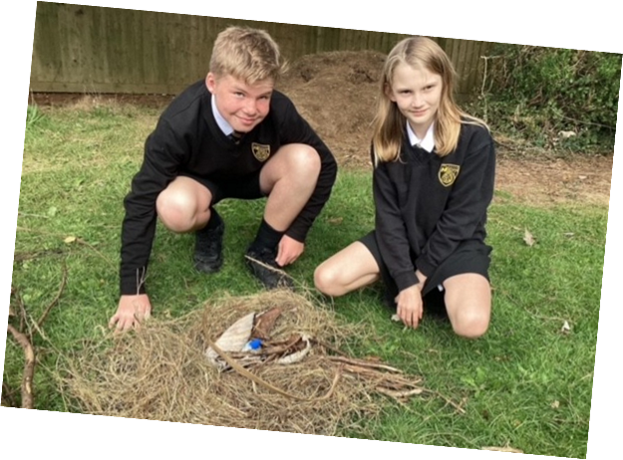
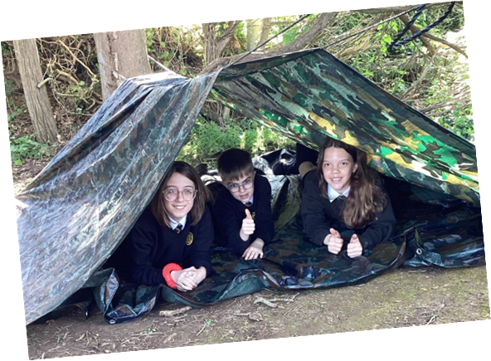
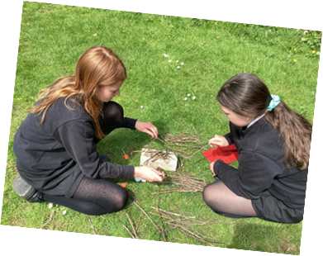
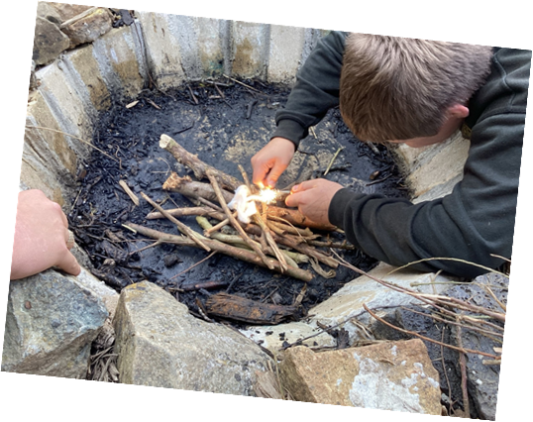
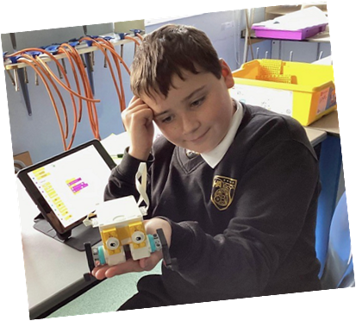
TEACHING AND LEARNING
THE IMPLEMENTATION OF OUR PROVISION

Slide 8
SEND STRATEGY
SEND Support
THE IMPLEMENTATION OF OUR PROVISION
LITERACY & NUMERACY – intervention sessions are run by our specialist teaching assistants to support those student significantly behind age related expectations. Literacy intervention sessions run daily for Year 7, 8 and 9 with RWI Freshstart Phonics based intervention for our lowest readers and Lexia PowerUp for those below ARE for reading. In addition to this, we run a peer reading mentoring programme with Yr7 partnered by Yr9 and Yr8 with Yr10 students. Our Numeracy intervention involves high pace, regular small group support throughout Yr7 & 8 during timetabled Maths lessons.
NURTURE – for students who may not be secondary ready or who have experienced trauma we provide four daily Nurture lessons in Year 7. The sessions are based on the principles of attachment and need for nurture with focuses on social and emotional skills via play, group working, cooking, arts and outdoor education to create a connection to self, others, nature and the school.
OUTDOOR EDUCATION – we run a weekly Outdoor Education session in Year 8 as well as intervention sessions in Yr8 and 9 for students needing outdoor education experiences. Students will develop their connection to self, others, nature and the school using outdoor learning activities such as fire lighting, shelter building, tool making and legacy projects within our newly created forest school and outdoor classroom areas.
SPECIALIST COURSES AT KS4 – in key stage 4 we offer the ASDAN course ‘My Independence’ for selected students to support their transition to post 16 education and preparation for adulthood. We also offer bespoke entry level qualifications for English, Maths and Science for students working below GCSE test levels.
DYSLEXIA SUPPORT – our dyslexic champion runs in house screening tests to understand areas of need and provides support via dyslexia workshops with groups of students and dyslexia clinics for those learners who need more specialist support.
SEMH PROVISIONS – alongside the support provided by the TIS trained pastoral team, the SEN team support our students with SEMH needs via 1to1 or small group draw and talk and TIS sessions. Students struggling to regulate are supported with zones of regulation intervention sessions. For those student’s whose anxiety or SEMH needs means they struggle to attend mainstream school, ‘The Hub’ is our in school alternative provision set up to support learning away from the main school environment and supports attendance progress also.
NEURODIVERSITY SUPPORT – run by our ASD and ADHD champions we run peer mentoring sessions where students with neurodiversity can meet with other students and share their experiences and advice. We also run a half termly Neuro Café for parents to meet and hear from specialists and share experiences and a weekly lunchtime drop in club for students.

Slide 9
TEACHING AND LEARNING
THE IMPLEMENTATION OF OUR PROVISION
Termly Reviews for Students with SEN
SENCO
Monitoring (using SISRA & other assessments)
KEY ADULT
Meets with the student after data capture to review attainment and progress – adapt targets.
PARENT
Individual Learning Plan sent home to parents for feedback and to inform them of provisions and targets.
TUTOR
Completes analysis using SISRA of academic attainment and progress.
TERMLY SEN REVIEW MEETING
Held between tutor and parent to discuss academic and pastoral progress.
FEEDBACK
From all stakeholders to SENCO and Key Adult to determine changes in provision, support needed.

Slide 10

TEACHING AND LEARNING
The role of the teacher and SEND
In relation to children/young people at risk of or with special educational needs/disabilities, class and subject teachers should: Ensure early identification of:
special educational needs;
barriers to learning;
appropriate interventions and actions (eg ‘graduated approach’, ‘SEN support’) in consultation with the SENCO;
Have full knowledge of children’s/young people’s ‘SEN support’ or Education, Health and Care Plans;
Provide access to a broad and balanced curriculum;
Understand and provide ‘high quality teaching’;
Have appropriate high expectations based on assessment;
Assume responsibility and accountability for their learning, progress and development;
Maintain responsibility for working with them on a regular basis, even when interventions involve group or one-to-one teaching/support away from the main class;
Regularly assess, monitor and review their progress (academic, developmental and social-emotional) during the course of the year with a view to ensuring the ultimate outcome of ‘a successful transition to adult life’
YOUR ROLE AS A TEACHER
Your main role is to help identify and overcome barriers to learning inside and outside the classroom.
Teachers are responsible and accountable for the progress and development of the pupils in their class, including where pupils access support from Teaching Assistants or specialist staff.
Teachers should work closely with any Teaching Assistants or specialist staff involved, to plan and assess the impact of support and interventions and how they can be linked to classroom teaching.
Working with the SENCO, teachers should revise the support in light of the pupil’s progress and development, deciding on any changes to the support and outcomes in consultation with the parent and pupil.
Through professional development, secure knowledge, understanding and skills around SEND

Slide 11
TEACHING AND LEARNING
SEND Provision and the Curriculum
THE SEND Strategy
The planning of our SEND provision has ensured a whole school curriculum approach to meeting the needs of those in each classroom who require an additional level of support.
The details of this are found in each faculty Curriculum Document and whilst the intent is a whole school approach, the implementation and impact are detailed to each subject area and the work carried out within.
Our overall intent is for an inclusive and ambitious curriculum for all, including SEND.
A high-quality education with fair access to the curriculum.
All students have equity in self-belief, self-worth and life chances.
The intent is broken down into the following statements, where the detail is added, and curriculum leaders demonstrate their understanding of the provision to enable success for all.
We provide a;
Inclusive curriculum that all SEND students can access
SEND students are able to know more, remember more and do more.
SEND students have clear 'end points' within the curriculum - SEND students have clear goals
SEND students' contributions and perspectives are valued and celebrated.

Slide 12

